Slide 1
RASA Chatbot Frameworks
atjahyanto@gmail.com

Slide 2
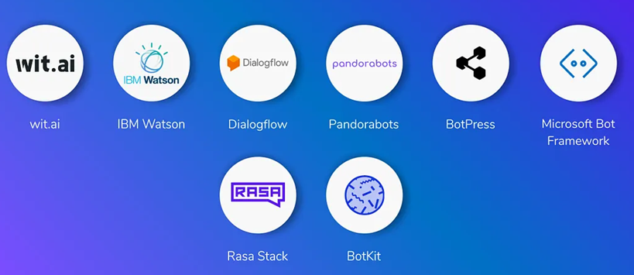
Chatbot Frameworks
Tools atau platform yang menyediakan kerangka kerja untuk membangun chatbot, sehingga pengembang tidak harus membuat semuanya dari nol.
Framework ini biasanya sudah punya fitur bawaan seperti Natural Language Understanding (NLU), dialog management, integrasi ke aplikasi pihak ketiga (misalnya WhatsApp, Telegram, Slack), dan deployment.
Contoh:
Rasa, Dialogflow, Botpress.

Slide 3
Beberapa Chatbot Framework
Framework | Kelebihan | Cocok untuk
Rasa 🐍 | Fleksibel, self-host, bisa kustom NLU | Enterprise, riset, chatbot kompleks
Botpress | UI visual, self-host/cloud, mudah dipakai | Bisnis kecil/menengah, chatbot sederhana
ChatterBot 🐍 | Instalasi mudah, Python library, cocok belajar | Edukasi, prototyping, chatbot dasar
Wit.ai | Gratis, multilingual, integrasi Facebook | Startup, chatbot sederhana, Messenger
Microsoft Bot Framework | SDK lengkap, integrasi Azure, enterprise ready | Perusahaan besar, multi-channel chatbot

Slide 4

RASA Framework
Framework open-source untuk membangun chatbot dan voice assistant yang cerdas.
Kelebihan:
Open-source & Python-based → bisa dikustom penuh.
Bisa self-hosted → privasi & kontrol data terjamin.
Mendukung integrasi ML (misalnya BERT, spaCy).
Kelemahan:
Setup rumit.
Butuh pengetahuan teknis (Python, ML, server).

Slide 5

RASA Framework
Tim RASA (Alan Nichol & Alex Weidauer) sengaja memilih kata “Rasa” karena:
pendek, mudah diingat,
bermakna “essence”,
sesuai tujuan framework: mengekstrak inti percakapan
Berasal dari bahasa Sanskerta yang berarti essence, juice, atau flavor
https://www.forbes.com/pictures/5a61df5931358e4955ab18cb/rasa-alan-nichol--alexand/

Slide 6
Setup Environment for RASA
Install python 3.10 atau 3.11 (misal di D:\python311)
Install package manager, masuk CMD, jalankan:
Create Virtual Environment
Install Rasa
powershell -ExecutionPolicy ByPass -c "irm https://astral.sh/uv/install.ps1 | iex"
mkdir my-rasa cd my-rasa
uv venv --python 3.11
.venv\Scripts\activate
Get license key
https://rasa.com/docs/learn/quickstart/pro
Setelah dikirimi email, Follow the simple steps in our installation guide.

Slide 7
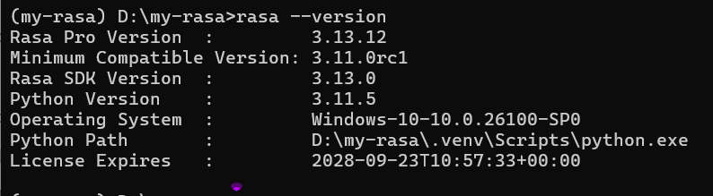
Setup Environment for RASA
Install Rasa
dari email
uv pip install rasa-pro
set RASA_LICENSE=YOUR_LICENSE_KEY
rasa --version

Slide 8
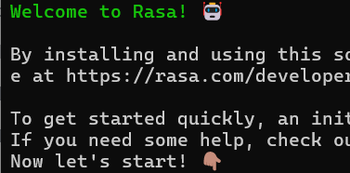
Setup Environment for RASA
Create a new template CALM assistant from a template
Type: myfirst-chatbot <ENTER>
Type: Y
Dan seterusnya
rasa init --template tutorial
Akses https://rasa.com/docs/pro/tutorial

Slide 9
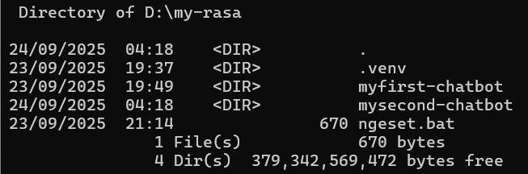
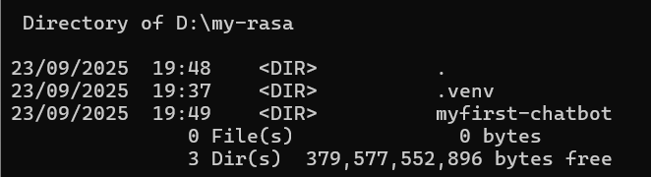
Testing myfirst-chatbot
Train dan run myfirst-chatbot
Open in Browser dan mulai percakapan dengan chatbot
dir
cd myfirst-chatbot
rasa train
rasa inspect

Slide 10
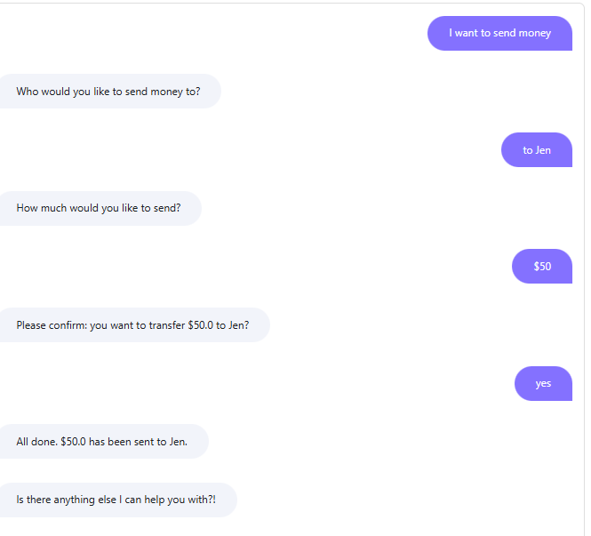
Testing myfirst-chatbot
Open in Browser dan mulai percakapan dengan chatbot
Ketik “hello”, jika chatbot sudah memberi respons. Lakukan percakapan seperti di samping.

Slide 12
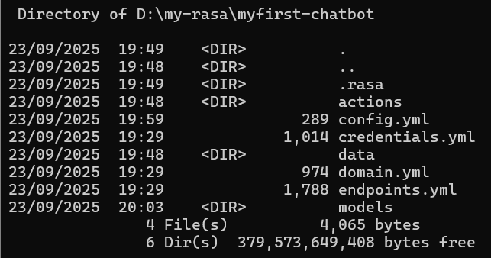
File yang terkait dengan myfirst-chatbot
File-file yang terkait dengan tutorial:
File data/flows.yml (versi RASA Pro 3.6+), berfungsi mendefinisikan alur percakapan (flows) yang lebih terstruktur dibandingkan dengan stories.yml (RASA open source).
data/flows.yml
domain.yml
actions/actions.py

Slide 13
File yang terkait dengan myfirst-chatbot
File domain.yml berfungsi sebagai jantung konfigurasi RASA yang mendefinisikan apa yang chatbot ketahui dan bisa lakukan.
Berisi definisi:
Intents → misal: book_ticket, greet.
Entities → informasi yang bisa diekstrak dari input user (misal: city, date).
Slots → variabel tempat menyimpan entity (misal: origin, destination).
Responses → teks/template jawaban chatbot (misal: utter_greet).
Actions → aksi custom yang dipanggil (misal: action_search_ticket).

Slide 14
File yang terkait dengan myfirst-chatbot
File actions/actions.py berisi custom actions dalam bentuk kode Python.
Action ini dijalankan ketika chatbot perlu melakukan sesuatu di luar jawaban statis
Misalnya:
Query ke database.
Memanggil API eksternal.
Mengolah data sebelum merespons user.

Slide 15
Contoh isi data/flows.yml
flows:
transfer_money:
description: Help users send money to friends and family.
steps:
- collect: recipient
- collect: amount
description: the number of US dollars to send
- action: utter_transfer_complete
File data/flows.yml berfungsi mendefinisikan alur percakapan (flows)

Slide 16
Contoh isi domain.yml
version: "3.1"
slots:
recipient:
type: text
mappings:
- type: from_llm
amount:
type: float
mappings:
- type: from_llm
responses:
utter_ask_recipient:
- text: "Who would you like to send money to?"
utter_ask_amount:
- text: "How much money would you like to send?"
utter_transfer_complete:
- text: "All done. {amount} has been sent to {recipient}."
File domain.yml digunakan mendefinisikan intent, entity, slot, response, action

Slide 17
Contoh isi actions/actions.py
from typing import Any, Dict, List, Text
from rasa_sdk import Action, Tracker
from rasa_sdk.events import SlotSet
from rasa_sdk.executor import CollectingDispatcher
class ActionCheckSufficientFunds(Action):
def name(self) -> Text:
return "action_check_sufficient_funds"
def run(
self,
dispatcher: CollectingDispatcher,
tracker: Tracker,
domain: Dict[Text, Any],
) -> List[Dict[Text, Any]]:
# hard-coded balance for tutorial purposes. in production this
# would be retrieved from a database or an API
balance = 1000
transfer_amount = tracker.get_slot("amount")
has_sufficient_funds = transfer_amount <= balance
return [SlotSet("has_sufficient_funds", has_sufficient_funds)]
File actions/actions.py berisi custom actions dalam bentuk kode Python.

Slide 18
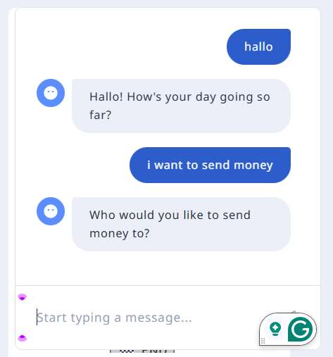
Contoh hasil percakapan

Slide 20
Menjalankan ulang RASA
cd myfirst-chatbot
.venv\Scripts\activate
set RASA_LICENSE=YOUR_LICENSE_KEY
rasa --version
rasa data validate
rasa train
rasa inspect

Slide 22
Mengatur chatbot: file config.yml
File konfigurasi utama di RASA yang berisi pengaturan:
Pipeline NLU → Alur processing input teks user sebelum pengenalan intent & entity.
Tokenizer (memecah teks jadi token kata/karakter)
Featurizer (mengubah kata jadi vektor)
Classifier (menentukan intent & entity).
Policies (Dialog Management) → Menentukan action/respon.
RulePolicy → aturan deterministik (greet, fallback, dsb.)
TEDPolicy → ML policy yang belajar dari stories.yml
MemoizationPolicy → mengingat percakapan yang sudah persis ada di training
FlowPolicy (RASA Pro) → menjalankan flows.yml.
recipe: default.v1
language: en
pipeline:
- name: CompactLLMCommandGenerator
llm:
model_group: rasa_command_generation_model
flow_retrieval:
active: false
policies:
- name: FlowPolicy
# - name: EnterpriseSearchPolicy
Konfigurasi default config.yml RASA Pro

Slide 24
Menyiapkan Percakapan Sederhana
Jangan lupa hapus dulu file flows.yml
version: "3.1"
stories:
- story: happy path 1
steps:
- intent: greet
- action: utter_greet
- story: happy path 2
steps:
- intent: mood_great
- action: utter_happy
- story: sad path 1
steps:
- intent: greet
- action: utter_greet
- intent: mood_unhappy
- action: utter_cheer_up
- action: utter_did_that_help
- intent: affirm
- action: utter_happy
- story: sad path 2
steps:
- intent: greet
- action: utter_greet
- intent: mood_unhappy
- action: utter_cheer_up
- action: utter_did_that_help
- intent: deny
- action: utter_goodbye
- story: User registration via form
steps:
- intent: user_regist
- action: utter_ask_name
- intent: provide_name
- action: utter_ask_email
- intent: provide_email
- action: utter_submit
version: "3.1"
intents:
- greet
- goodbye
- affirm
- deny
- mood_great
- mood_unhappy
- bot_challenge
- provide_name
- provide_email
- user_regist
- show_info
entities:
- name
- email
slots:
name:
type: text
influence_conversation: true
mappings:
- type: from_entity
entity: name
email:
type: text
influence_conversation: true
mappings:
- type: from_entity
entity: email
forms:
user_registration_form:
required_slots:
- name
- email
responses:
utter_greet:
- text: "Hey! How are you?"
utter_cheer_up:
- text: "Here is something to cheer you up:"
image: "https://i.imgur.com/nGF1K8f.jpg"
utter_did_that_help:
- text: "Did that help you?"
utter_happy:
- text: "Great, carry on!"
utter_goodbye:
- text: "Bye"
utter_iamabot:
- text: "I am a bot, powered by Rasa."
utter_ask_name:
- text: "What is your name?"
utter_ask_email:
- text: "What is your email?"
utter_submit:
- text: "Thanks {name}, we have registered your email: {email}."
session_config:
session_expiration_time: 60
carry_over_slots_to_new_session: true
version: "3.1"
language: "en"
# -------------------------
# NLU Pipeline
# -------------------------
pipeline:
- name: WhitespaceTokenizer # memecah teks jadi token
- name: RegexFeaturizer # untuk pola regex
- name: LexicalSyntacticFeaturizer # fitur linguistik
- name: CountVectorsFeaturizer # BoW untuk intent/entity
- name: CountVectorsFeaturizer # char n-grams
analyzer: char_wb
min_ngram: 1
max_ngram: 4
- name: DIETClassifier # intent + entity recognition
epochs: 100
- name: EntitySynonymMapper
- name: ResponseSelector # opsional, untuk FAQ
epochs: 100
- name: NLUCommandAdapter # adapter ditambahkan di sini
# -------------------------
# Dialogue Policies
# -------------------------
policies:
- name: MemoizationPolicy # mengingat persis dari stories
max_history: 5
- name: RulePolicy # untuk aturan fix (greet, fallback)
core_fallback_threshold: 0.3
core_fallback_action_name: "action_default_fallback"
enable_fallback_prediction: true
- name: TEDPolicy # ML policy utama untuk belajar dari stories.yml
max_history: 5
epochs: 100
constrain_similarities: true
assistant_id: 20250924-045037-leather-model
version: "3.1"
nlu:
- intent: greet
examples: |
- hey
- hello
- hi
- hello there
- good morning
- good evening
- moin
- hey there
- let's go
- hey dude
- goodmorning
- goodevening
- good afternoon
- intent: goodbye
examples: |
- cu
- good by
- cee you later
- good night
- bye
- goodbye
- have a nice day
- see you around
- bye bye
- see you later
- intent: affirm
examples: |
- yes
- y
- indeed
- of course
- that sounds good
- correct
- intent: deny
examples: |
- no
- n
- never
- I don't think so
- don't like that
- no way
- not really
- intent: mood_great
examples: |
- perfect
- great
- amazing
- feeling like a king
- wonderful
- I am feeling very good
- I am great
- I am amazing
- I am going to save the world
- super stoked
- extremely good
- so so perfect
- so good
- so perfect
- intent: mood_unhappy
examples: |
- my day was horrible
- I am sad
- I don't feel very well
- I am disappointed
- super sad
- I'm so sad
- sad
- very sad
- unhappy
- not good
- not very good
- extremly sad
- so saad
- so sad
- intent: bot_challenge
examples: |
- are you a bot?
- are you a human?
- am I talking to a bot?
- am I talking to a human?
- intent: provide_name
examples: |
- My name is Ali
- I am John
- It's Sarah
- My name Budi
- intent: provide_email
examples: |
- My email is ali@example.com
- My email is budi@example.com
- You can reach me at john@mail.com
- intent: user_regist
examples: |
- I want to register
- Registration please
- I am a new user
- intent: show_info
examples: |
- Show me my registration
- What did I give?
- Review my data
domain.yml
data/nlu.yml
data/stories.yml
config.yml

Slide 25
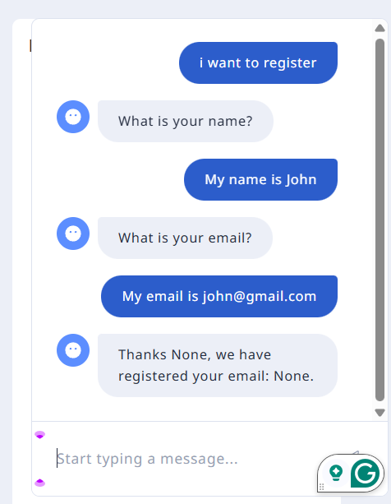
Contoh Simulasi Dialog
Entity belum dapat dikenali !!

Slide 27
Contoh isi nlu.yml
version: "3.1"
nlu:
- intent: greet
examples: |
- hey
- hello
- hi
- hello there
- good morning
- good evening
- moin
- hey there
- let's go
- hey dude
- goodmorning
- goodevening
- good afternoon
- intent: goodbye
examples: |
- cu
- good by
- cee you later
- good night
- bye
- goodbye
File nlu.yml dipakai untuk melatih NLU (Natural Language Understanding).
Isinya berupa contoh-contoh kalimat (training examples) yang dihubungkan dengan intent dan kadang entity.
version: → versi schema (misalnya "3.1").
nlu: → root key untuk daftar intent dan training data.
intent: → nama intent (harus ada di domain.yml).
examples: | → list contoh kalimat (gunakan - untuk setiap contoh).

Slide 28
Contoh isi nlu.yml
version: "3.1"
nlu:
- intent: greet
examples: |
- hey
- hello
- hi
- hello there
- good morning
- good evening
- lookup: location
examples: |
- Jakarta
- Bandung
- Bali
- Surabaya
- regex: zipcode
examples: |
- \d{5}
- synonym: NYC
examples: |
- New York
- New York City
Selain entity, file nlu.yml dapat berisi lookup table, synonym, regex entity.

Slide 29
Contoh isi stories.yml
version: "3.1"
stories:
- story: happy path 1
steps:
- intent: greet
- action: utter_greet
- story: happy path 2
steps:
- intent: mood_great
- action: utter_happy
- story: sad path
steps:
- intent: mood_unhappy
- action: utter_cheer_up
- story: User registration via form
steps:
- intent: user_regist
- action: utter_ask_name
- intent: provide_name
- action: utter_ask_email
- intent: provide_email
- action: utter_submit
File stories.yml berisi cerita dialog yang menggambarkan alur percakapan antara user (intent) dan bot (action/response).
Untuk melatih model dialog manager.
Isinya adalah contoh “jalan cerita” (conversation path) dalam format YAML.
story: → nama cerita, hanya label supaya mudah dibaca.
steps: → daftar langkah percakapan:
intent: → apa yang user ucapkan (harus ada di nlu.yml & domain.yml).
action: → respon bot (bisa berupa utter_xxx atau custom action dari actions.py).

Slide 30
Contoh isi domain.yml
version: "3.1"
intents:
- greet
- goodbye
- provide_email
- user_regist
- show_info
entities:
- name
- email
slots:
name:
type: text
influence_conversation: true
mappings:
- type: from_entity
entity: name
email:
type: text
influence_conversation: true
mappings:
- type: from_entity
entity: email
responses:
utter_greet:
- text: "Hey! How are you?"
utter_happy:
- text: "Great, carry on!"
File domain.yml adalah “jantung” RASA, karena di sinilah didefinisikan:
intent apa saja yang dikenali,
entity yang dipakai,
slot yang menyimpan data,
responses (template jawaban bot),
form
session_config (mengatur sesi percakapan)
actions (custom atau bawaan).

